Slide 1

Chasing PCs

Slide 2

CS- PCs

Slide 3

CS+ PCs

Slide 4

Shaping PCs

Slide 5
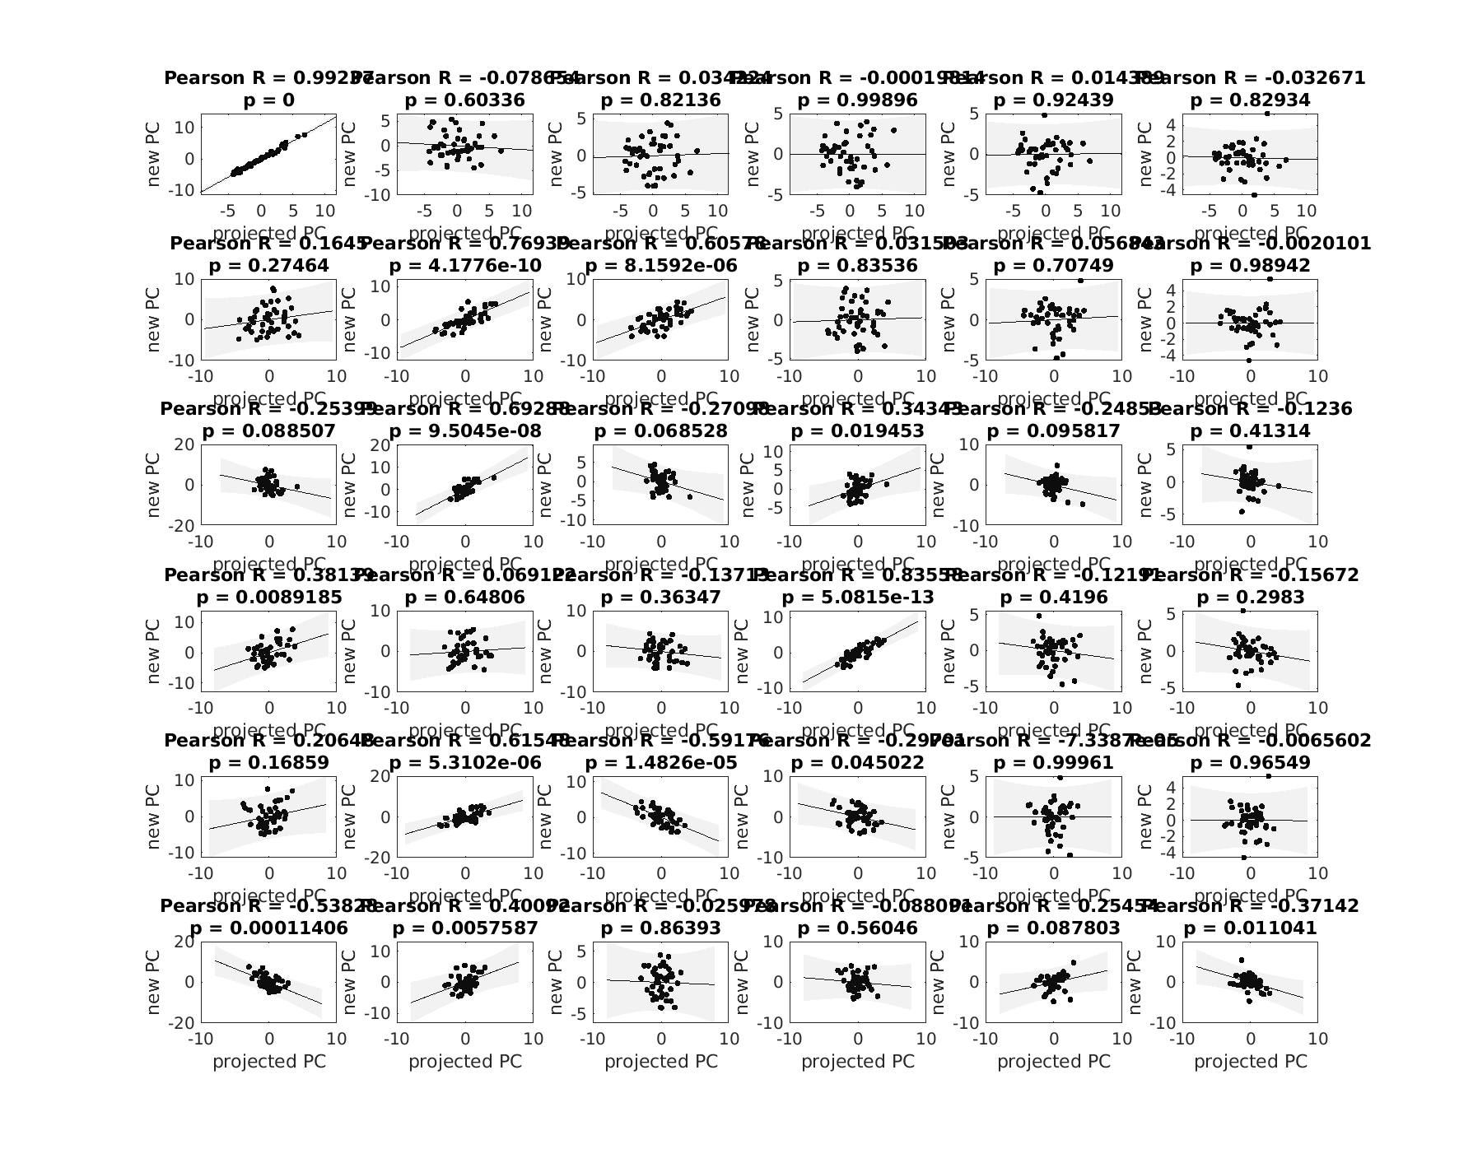
Switching PCs

Slide 6
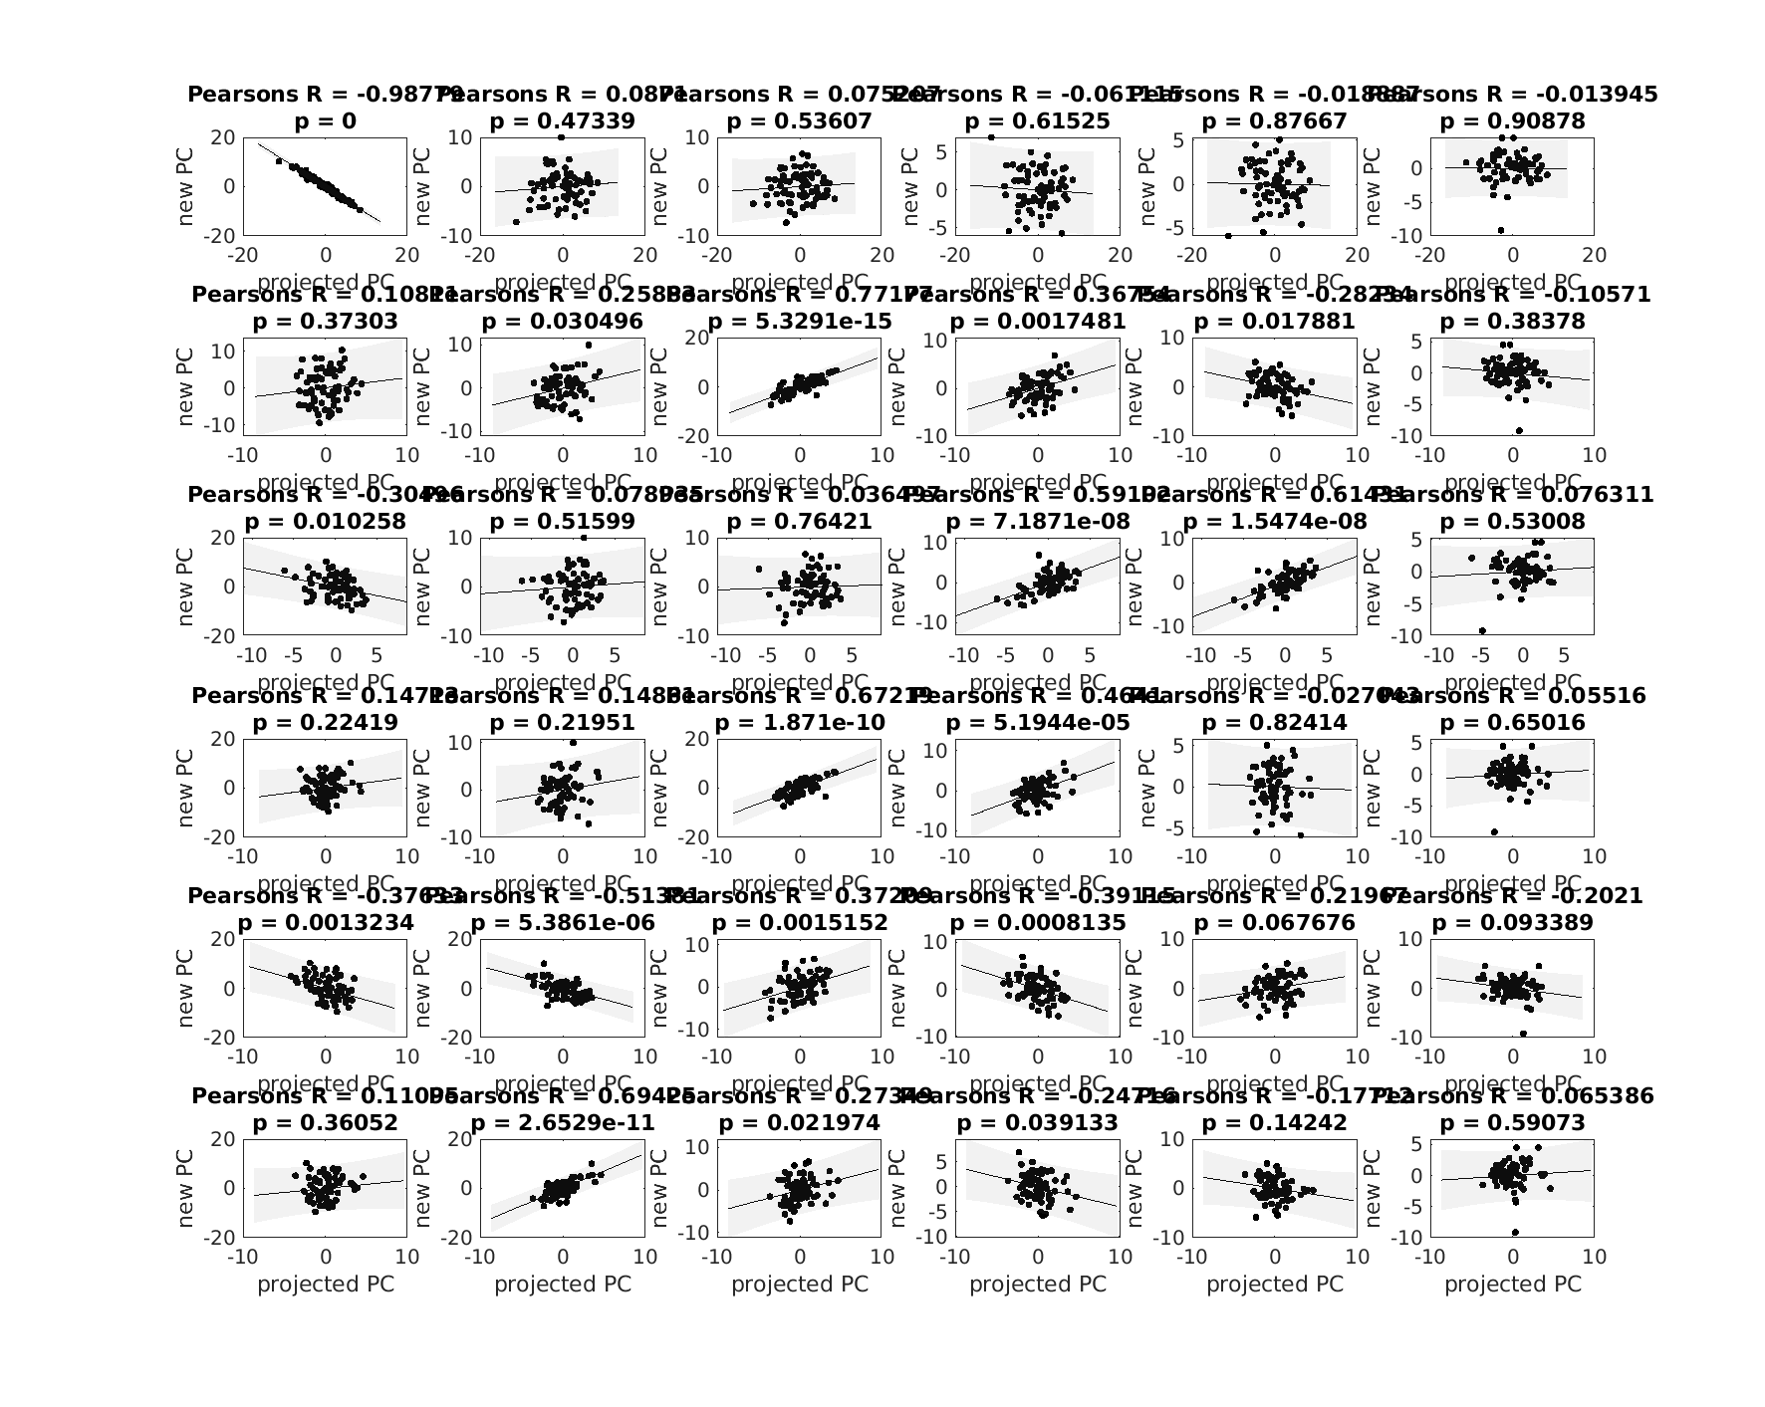
Social interaction PCs

